Slide 1
LENDING CLUB
This assignment will give you an idea about how real business problems are solved using EDA. In this case study, apart from applying the techniques you have learnt in EDA, We will also develop a basic understanding of risk analytics in banking and financial services and understand how data is used to minimise the risk of losing money while lending to customers.

Slide 2
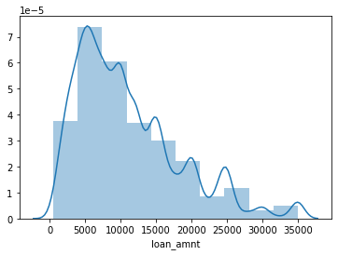
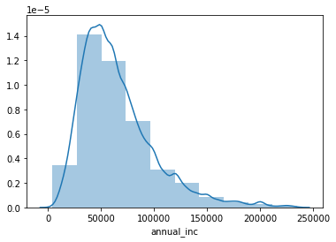
Loan Accepted considering all this conditions

Slide 3
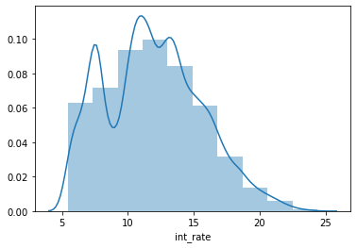
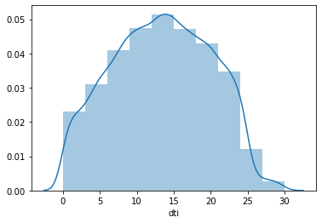
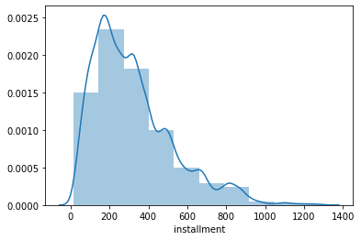

Slide 4
To minimise the risk of losing money while lending to customers important variables to be taken care of are:-
Loan Amount
Address State
Loan Term
Internal Grade classification of Loan
Employment Length
Interest Rate
Loan Purpose

Slide 5
Risk Analysis for Home ownership and purpose
Customers who do not mention their home ownership status properly (home ownership status mentioned as "Others") while applying for loan have more likely to default.
In the purpose of loan we can see that small business, renewable energy ,educational, are more prone to default.

Slide 6
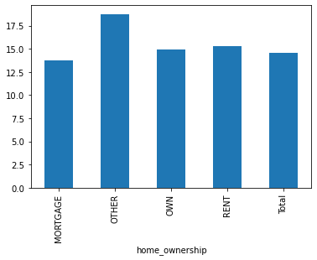
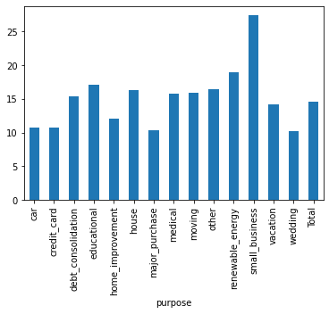
Default Rate V/S homeownership Default Rate v/s Purpose of loan

Slide 7
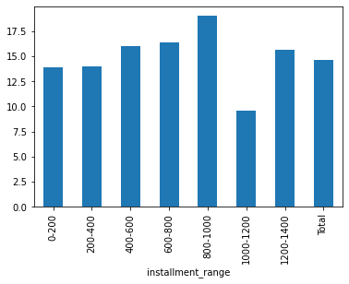
Risk analysis for interest rate range and instalment range
Higher the installment amount - higher the rate of default. However, this trend is a little weak. As such, this may not always be true.
There is a strong trend that higher the interest rate --> higher is the likelihood of default. Especially, loans with 20% plus interest rates are significantly prone to default.

Slide 8
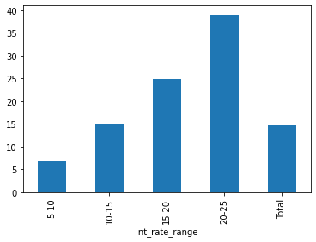

Slide 9
Risk Analysis for employment Customers having no employment experience have highest loan Default rate even though, based on total no. customers with 10 year plus experience have most charged off loans.

Slide 10
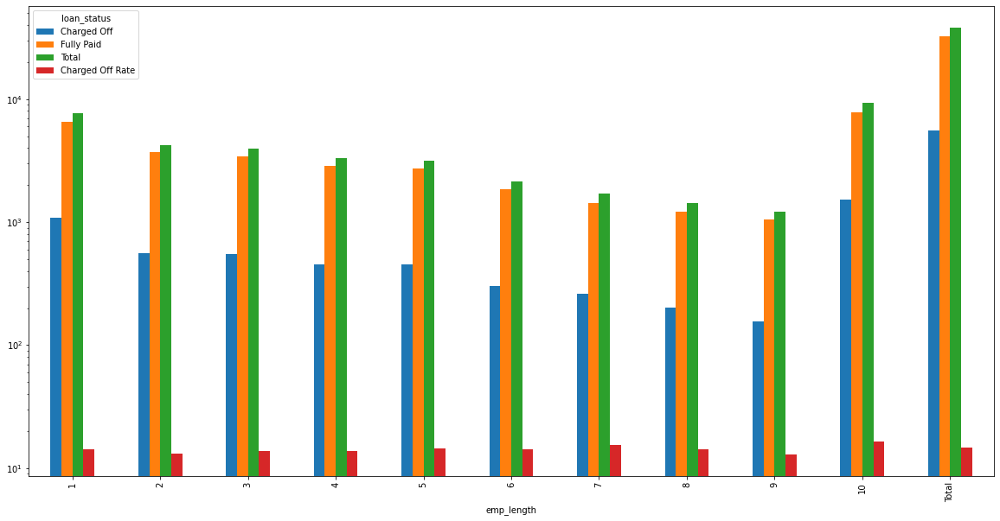

Slide 11
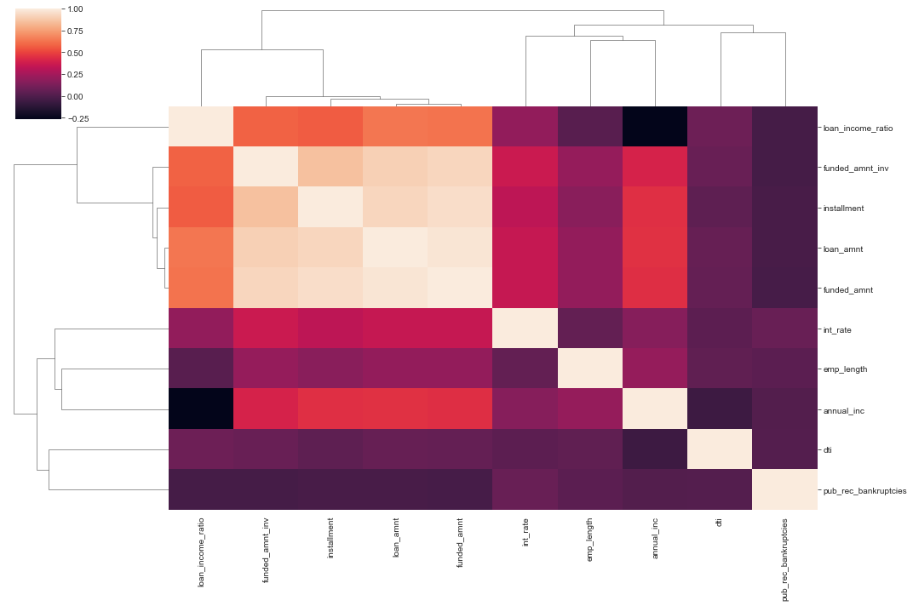
Heat map-Correlation of different variables

Slide 12
Conclusion
Higher the loan amount --> higher is the risk of applicants committing a default
Lesser the annual income - higher the rate of default. However, this trend is a little weak. As such, this may not always be true.
There is a strong trend that higher the interest rate --> higher is the likelihood of default. Especially, loans with 20% plus interest rates are significantly prone to default
Higher the installment amount - higher the rate of default. However, this trend is a little weak. As such, this may not always be true.
As Debt-to-Income ratio goes on increasing the likelihood of default also goes on increasing. However, this trend is also little weak
Lending Club should be extra vigilant while processing & approving a loan application when any of above indicators are observed.

